Slide 1
ELSB Light Harwesting
1.Energy-efficient lighting control through Lux-based Automation & Scheduling
Objective
To achieve automatic light control based on ambient lux level.
To reduce energy consumption by maintaining optimal brightness.
To integrate manual, automatic, and schedule-based control logic.

Slide 2
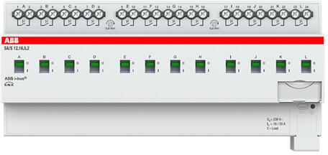
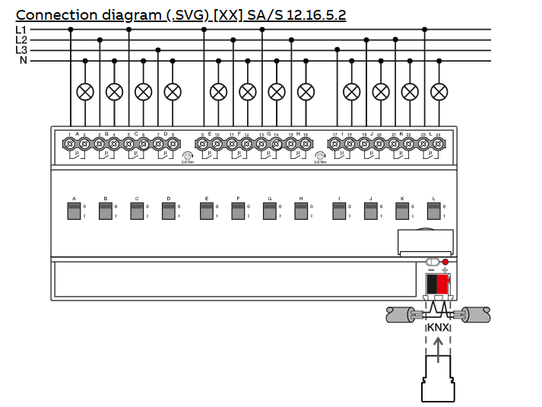
Actuators SA/S 12.16.5.2
 | A. Control ON/OFF for lighting circuits
The switch actuator uses potential free contacts to switch 12 independent electrical loads via the ABB i-bus® KNX. The device features a manual operation and displaying of the switching state of the outputs. The 16/20 A, 16 A-AC3 (C-load) device is especially suited for loads with high surge currents e.g. flourescent lighting acc

Slide 3
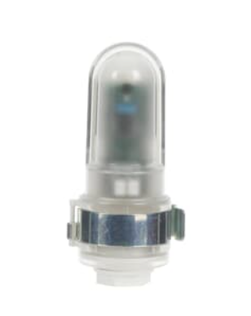
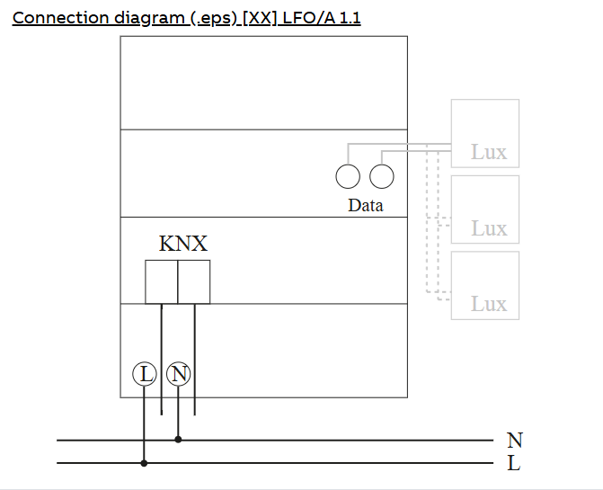
LF/O 1.1 Sensor
 | B. Lux sensor providing ambient light level (lux) data
Outside Light Sensor for the connection with the Interface HS/S 4.2.1.

Slide 4
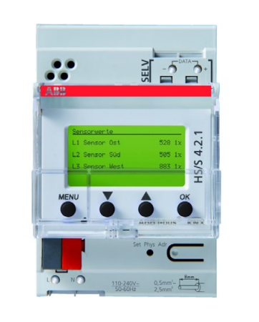
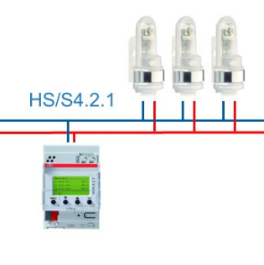
HS/S 4.2.1 Controller
C. ABB KNX logic controller handling light automation logic
HS/S4.2.1 measures the brightness with 1, 2 or 3 external data bus sensors. The measured values can be sent to the bus.
The device can be used as a twilight switch (1 ... 100 lux) or as a light value switch (100 ... 20.000 lux). One Outside Light Sensor LFO/A 1.1 is supplied with the device.

Slide 5
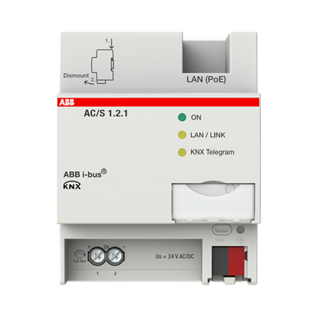
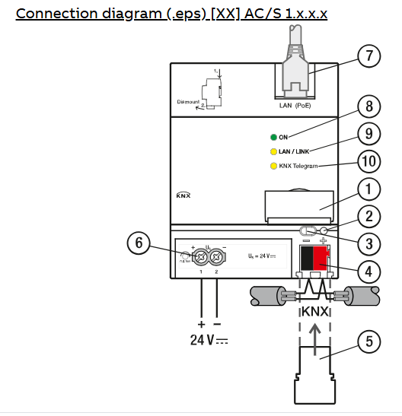
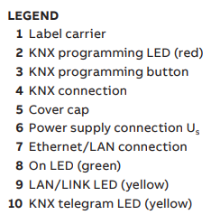
AC/S (BACnet Gateway)
 | D. Interface for logic automation and BACnet communication
Automation Controller with pre-defined Automation Modules for a holistic Heating, Ventilation and Air Conditioning (HVAC) Automation Solution from Central HVAC to Room Automation to meet the Energy Efficiencies Objectives like EN 15232 or LEED. Automation Modules for example Schedule, Set Point Calculation, Heat Curve Calculation, Data Logging and Device Monitoring. Own Automation Modules can be created by a graphical Logic Editor. The Controller has an automatic generated web based User Interface to monitor and manage the KNX System.
Built in BACnet/IP Gateway to connect the KNX System with Building Management Systems (BMS). Bidirectional data exchange between KNX and BACnet. The Engineering is done completely by the ETS. An additional external Software is not required

Slide 6
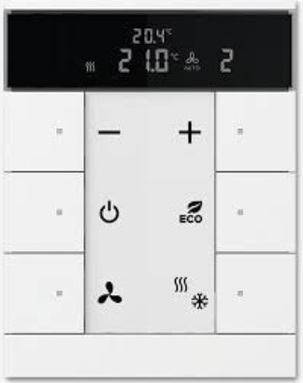
6-Button Keypad SBR/U6.0.1
 | E. Manual zone control and override functions
Freely configurable multifunction control element. With integrated KNX bus coupler. With labelling field. Support of KNX functions through innovative colour concept (yellow=lighting, blue=blind, orange=RTC, magenta=scene and white=neutral/no function assigned) or standard illumination red/green. Push switch function: switching / dimming / blind / sending values / scenes etc. For activating heating, ventilation and fan coil actuators. Master/slave configuration. With base-load operation. The fan stage can be switched manually or in automatic mode. Class of temperature controller 1 Contribution to space heating energy efficiency 1,0%. Number of bus subscribers

Slide 7
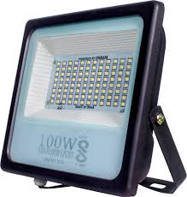
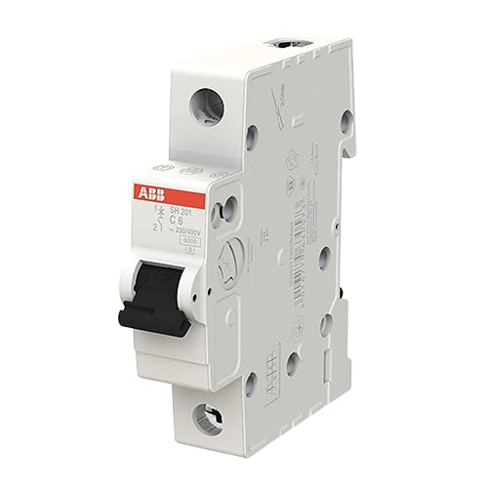
Working Principle
LF/O 1.2 Sensor measures current ambient lux.
HS/S 4.2.1 Controller receives lux value
Ac/s 1.2.1 processes logic.
If Lux < 90 → Lights Turn ON
If Lux > 90 → Lights Turn OFF
System maintains target lux by automatically adjusting lighting
Lux Measure
Processes Logic
AUTO/MANUAL
Schedule
If Lux < 90 → Lights Turn ON
If Lux > 90 → Lights Turn OFF
Lux Sensors
Process
Controls
MCB protection
Loads
KeyPad

Slide 8
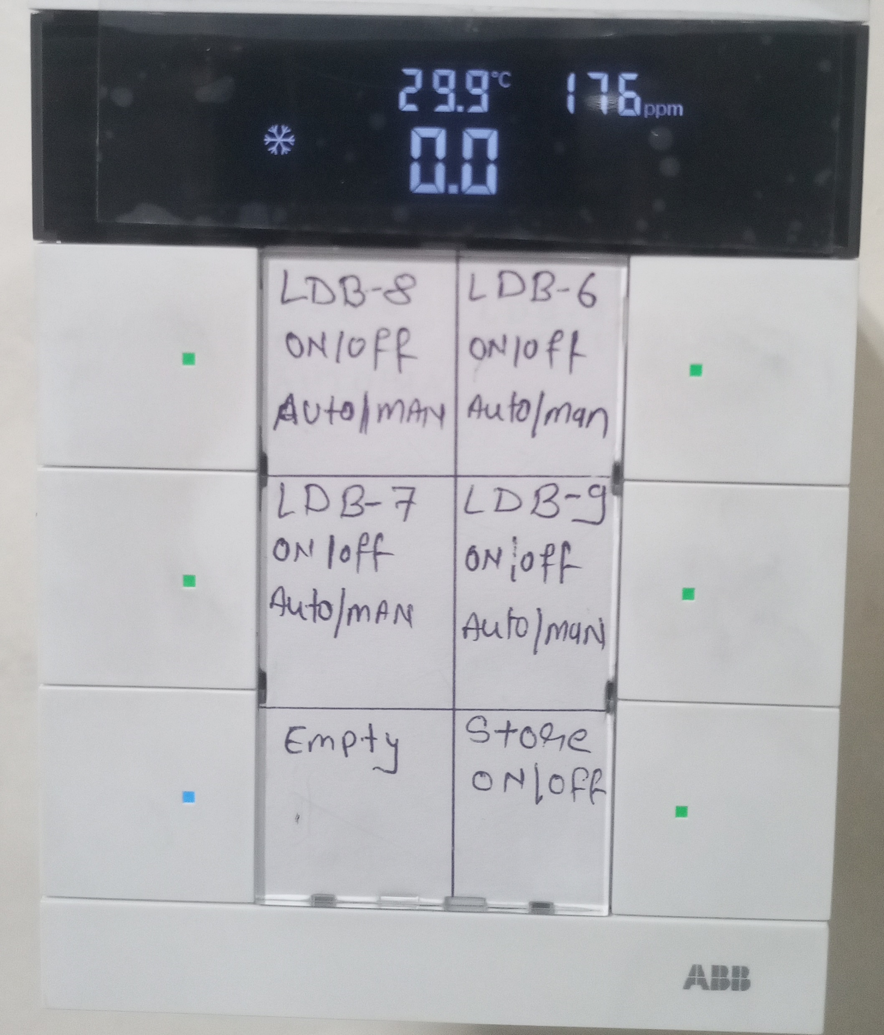
Control Logic Overview
Room Temprature
Lux value in Average
Lux-based Control: Lights ON/OFF depending on measured lux value.
Auto / Manual Mode:
Auto Mode: System runs by lux logic.
Manual Mode: User overrides logic using keypad.
Schedule Logic:
System works only when schedule is active.
When schedule = OFF → All lights OFF regardless of lux.
RED Indication Shows The LDB-8 is in Manual Mode
Green Indication Shows The LDB-8 is in Auto Mode
6-Button Keypad Configured:
Button 1–4: Double press = disables lux + schedule logic for that zone (manual override).
Button 1–4: Single Press= make ON/OFF the Shop Floor Lights (manual override).
Button 5: Spare (future use).
Button 6: Dedicated for Store Room → Manual ON/OFF only.
Blue Indication Shows the Key is Empty

Slide 9
System Logic Flow Diagram
Example:
Start
↓
Read Lux (from LF/O 1.2)
↓
Process : Is Schedule ON?
├─No → Lights OFF
└─Yes → Is Auto Mode?
├─No → Manual Control (Keypad)
└─Yes → Is Lux < 90?
├─Yes → Lights ON
└─No → Lights OFF

Slide 10
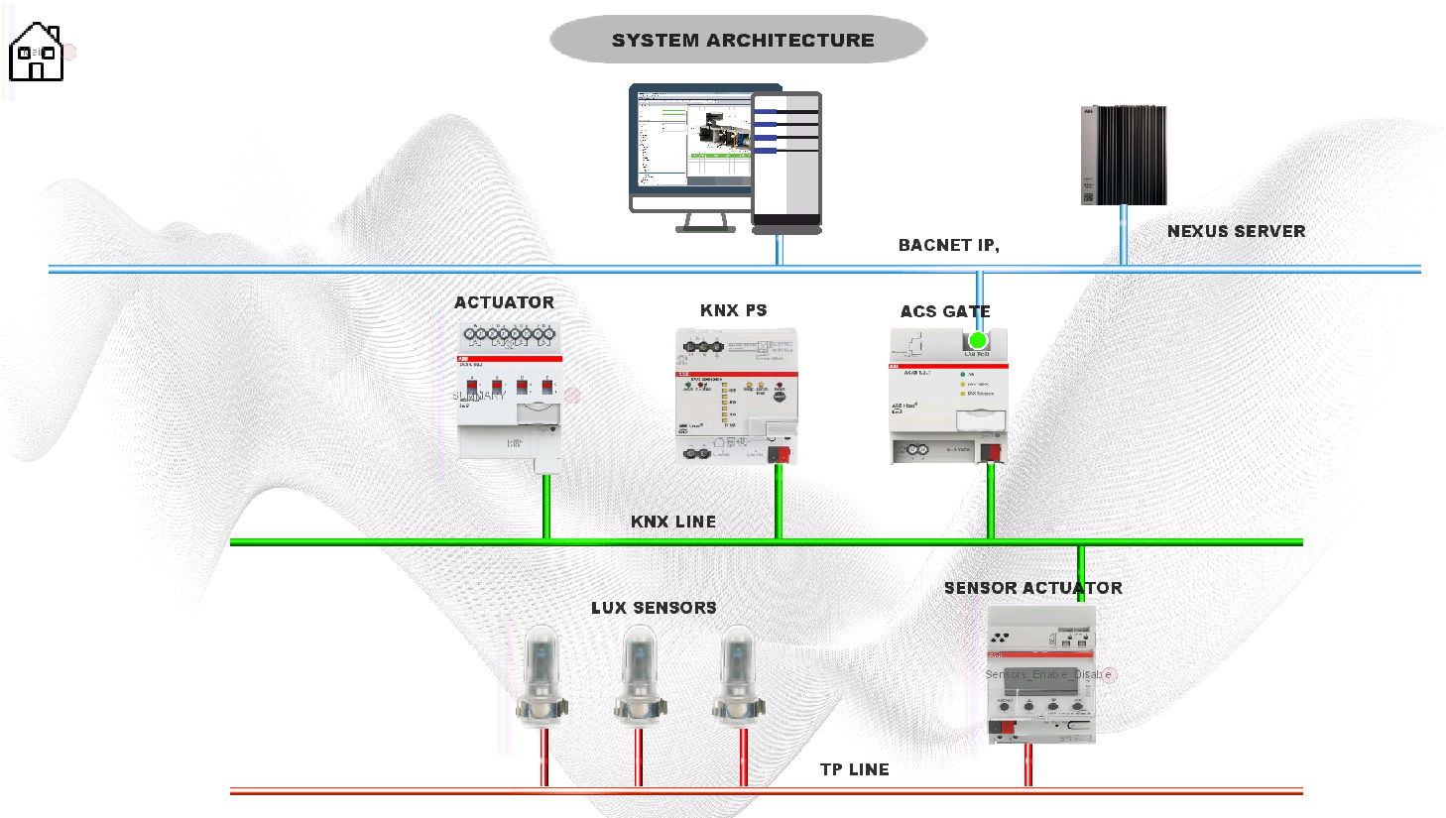
Communication & Integration
KNX Bus Communication between HS/S, sensors, keypads, and actuators.
BACnet Integration via AC/S controller for building management.
Logic handled within HS/S 4.2.1 using ABB Logic Automation tool.
BMS Server
BMS UI
Networking Line
KNX Line
Sensor Line

Slide 11
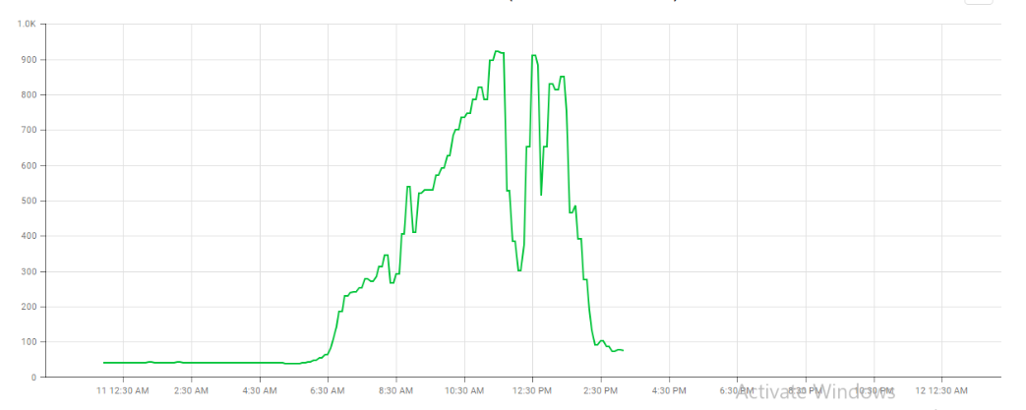
Calibration & Testing
Calibrated LF/O 1.2 to align lux readings with actual ambient levels.
Verified logic under different lighting conditions.
Tested schedule and manual override functions zone-wise.
Calibrated LF/O 1.2 to align lux readings

Slide 12


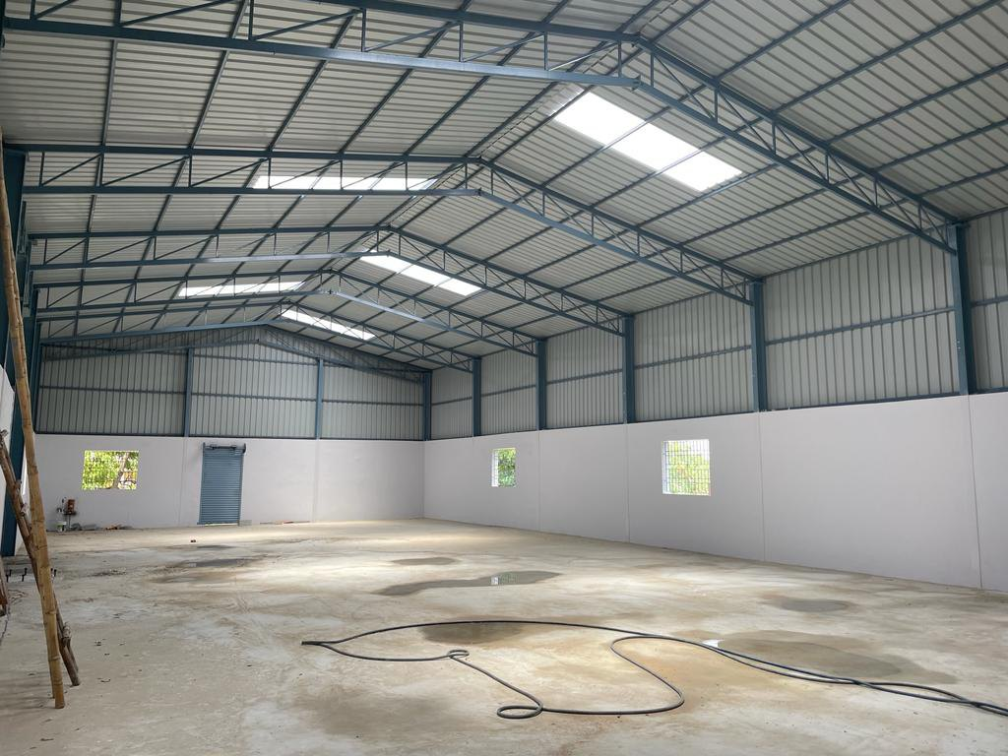
Results & Benefits
✅ Automatic lux-based control achieved ✅ Energy saving during high daylight availability ✅ Manual & schedule override flexibility ✅ User-friendly keypad interface ✅ Integrated with BMS via BACnet
Energy saving
User-friendly keypad
Integrated with BMS
Automatic lux-based

Slide 13
Conclusion
Successfully implemented smart light harvesting system.
Achieved energy efficiency and user comfort using ABB KNX platform.
Can be expanded with dimming control or presence sensors for future optimization.

Slide 14
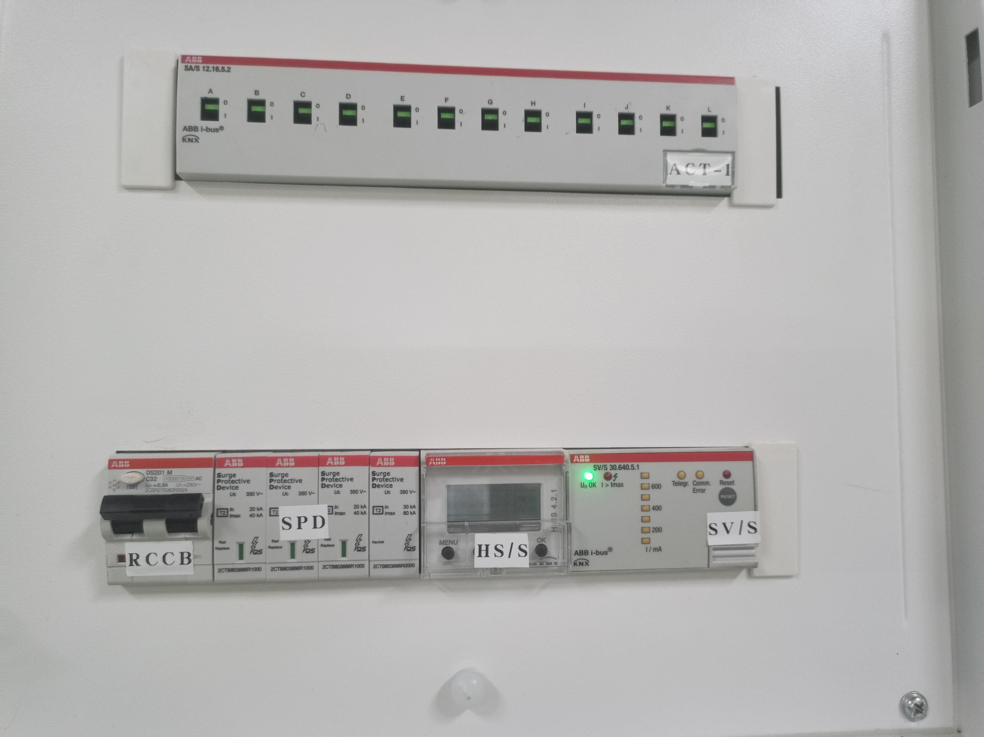
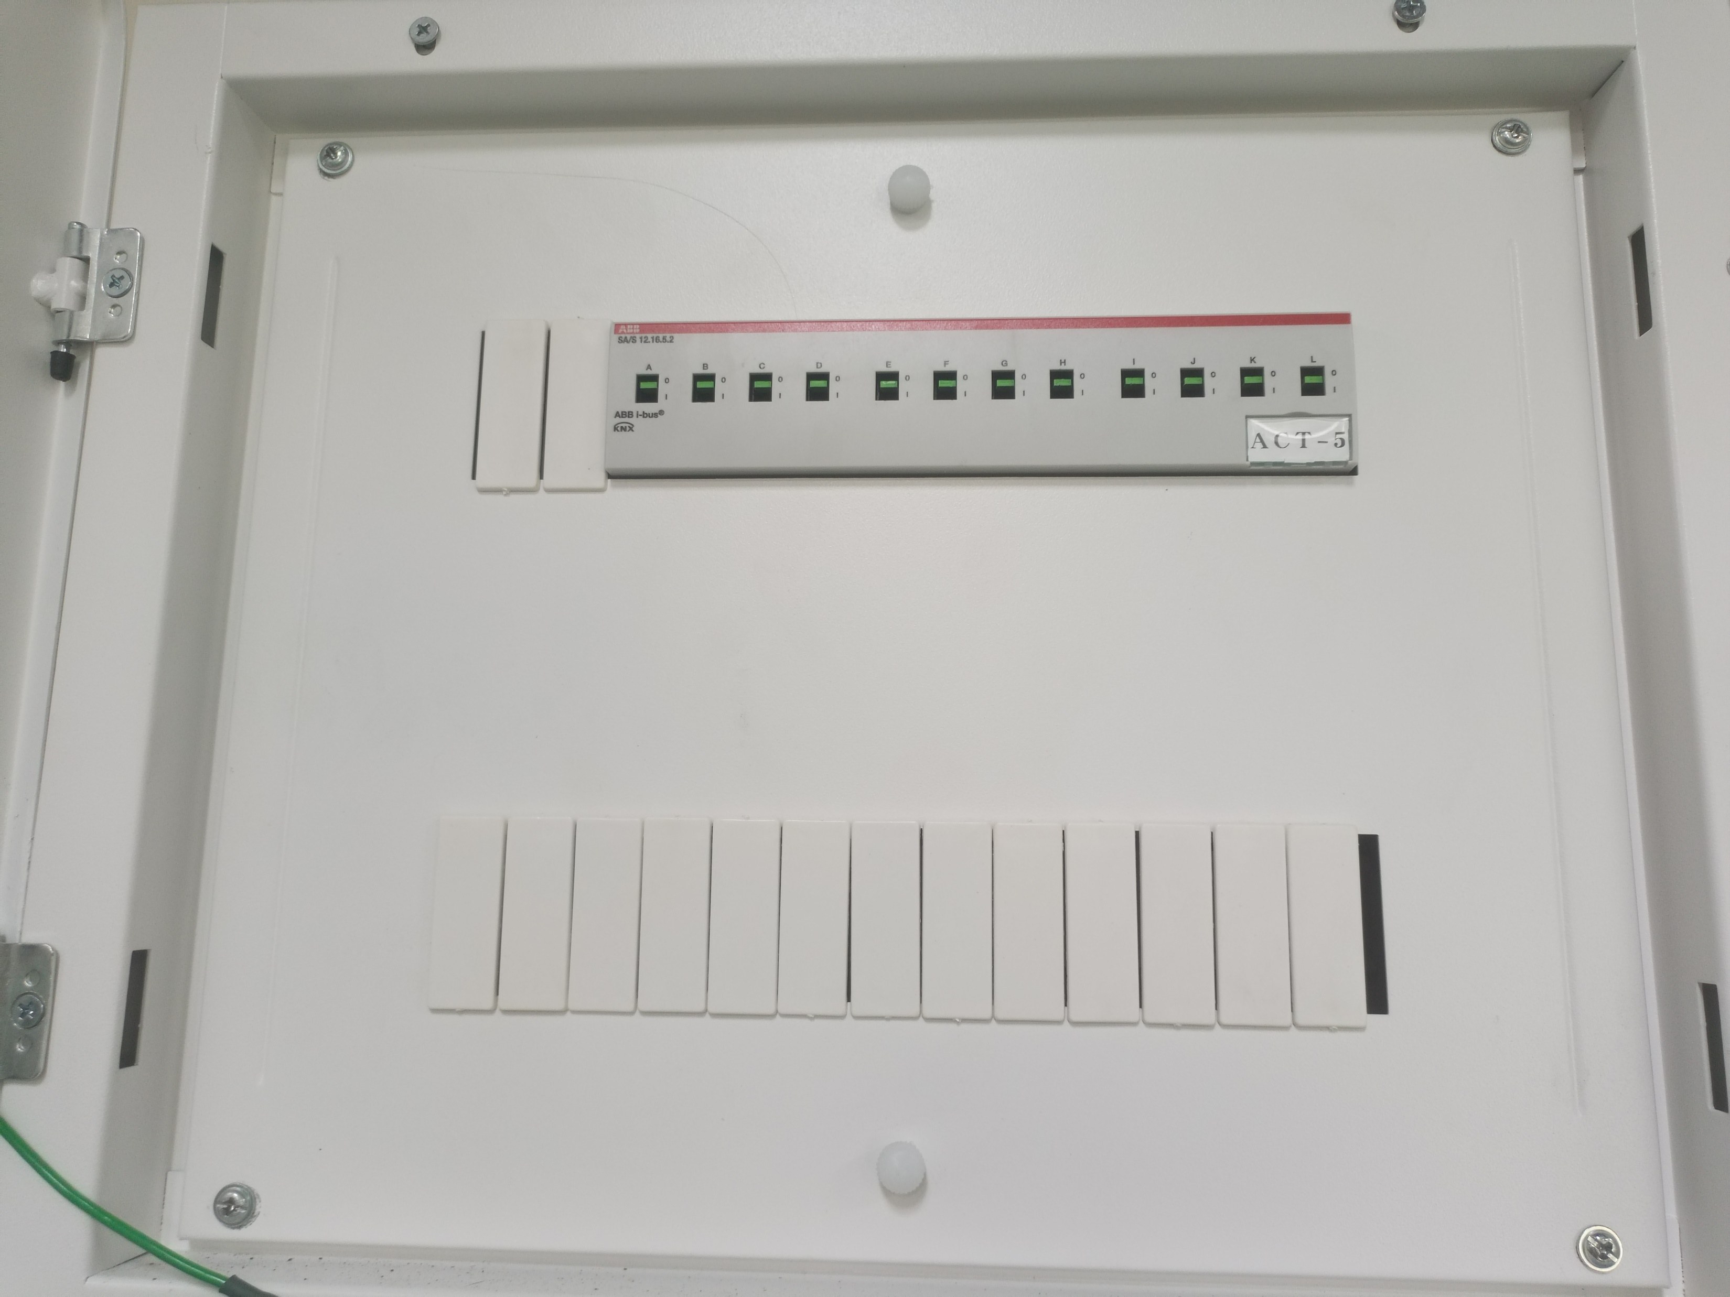
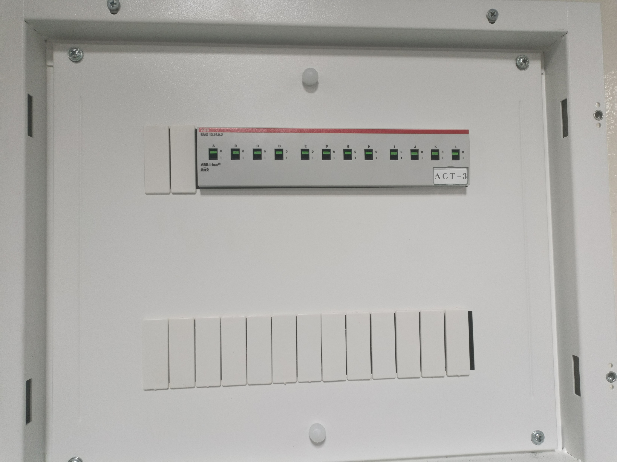
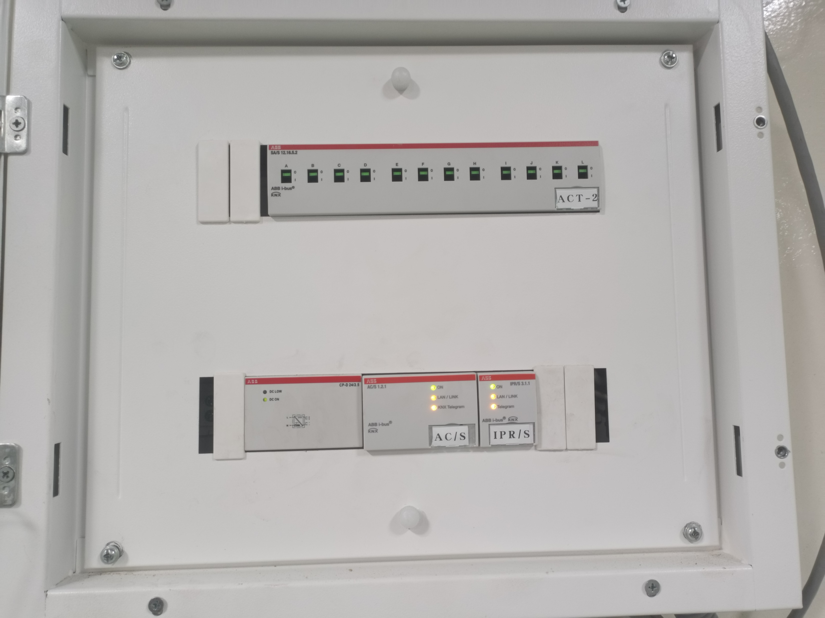
LMS DB Images
LMS DB LDB-9
LMS DB LDB-7
STORE LMS DB
LMS DB LDB-6
LMS DB LDB-9
STORE LMS DB GF

Slide 15
Thanks You

